Slide 1
ALTAIR Series APP – AC Freedom
Global Product Management
May 30, 2018

Slide 2
AC Freedom
APP Introduction
WIFI Module Installation
Model for 60Hz 115V 12K High Wall Inverter
Model for others
60Hz 230V High Wall Inverter
60Hz 230V High Wall Fixed
60Hz 115V High Wall Fixed
50Hz 220V High Wall Inverter
50Hz 220V High Wall Fixed

Slide 3
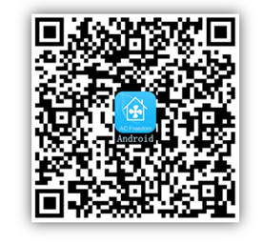
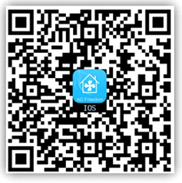
APP
APP Name
AC Freedom
Mobile Phone
Operation system : Android and iOS
Android System
IOS System

Slide 4
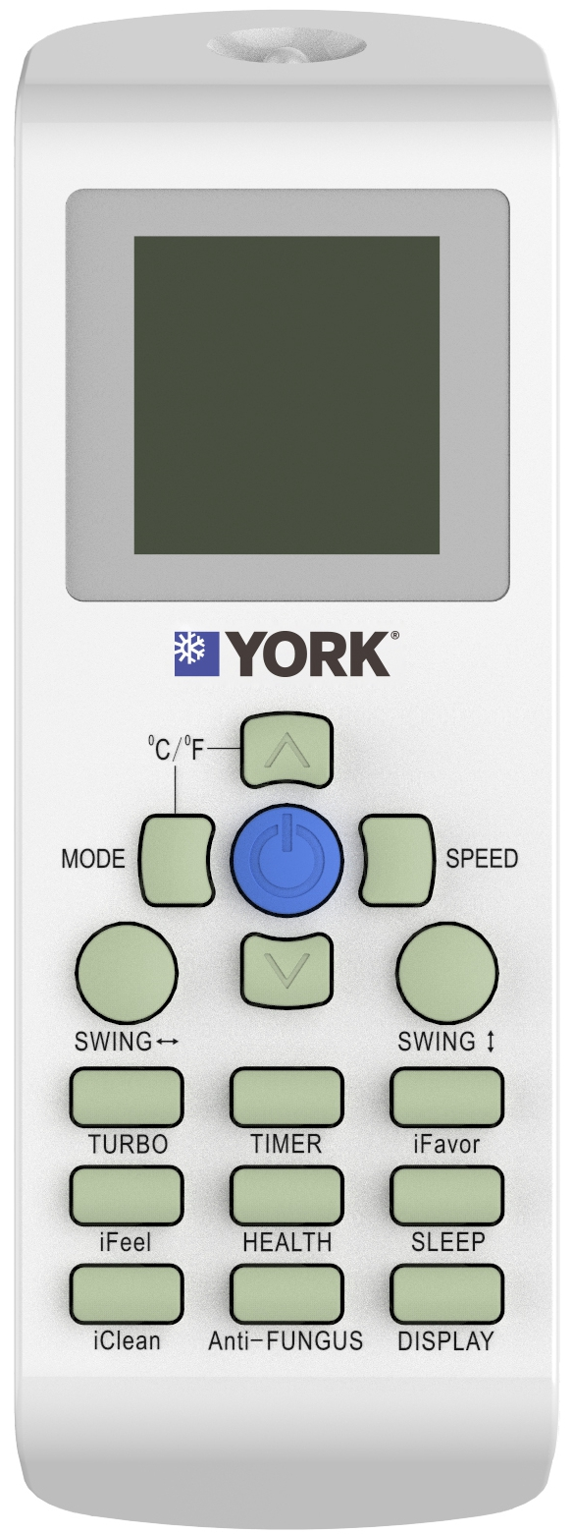
Initializes WIFI module
Press the “HEALTH” button quickly for 8 times.
Time should be less than 2s between 2 press.
Wait for the double beep voice.
Initialization finished.
Press
8 times

Slide 5
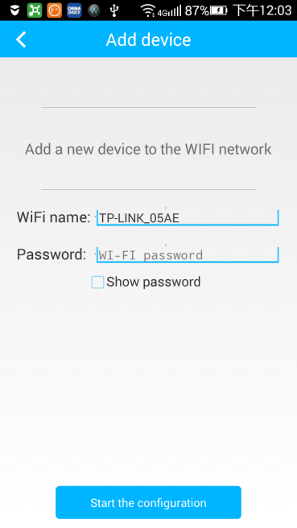
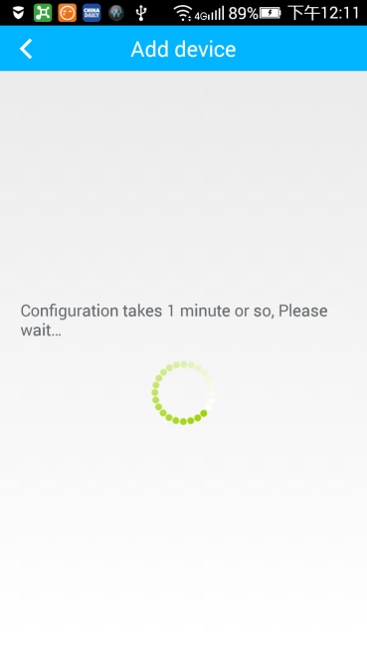
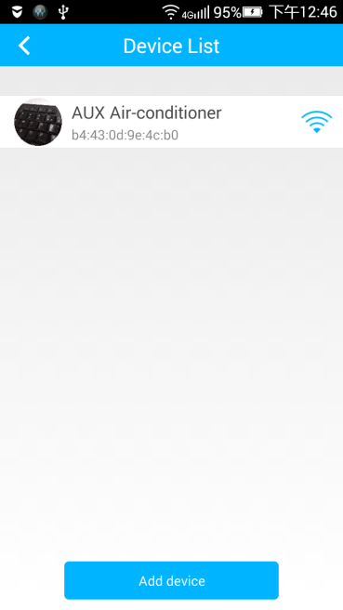
Configuration
Connect WIFI and Open the APP
Type in the WIFI name and password
Configuration takes up to about 1 min.
Successful Configuration

Slide 6
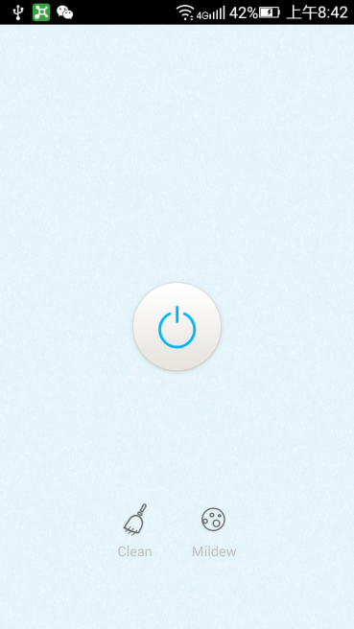
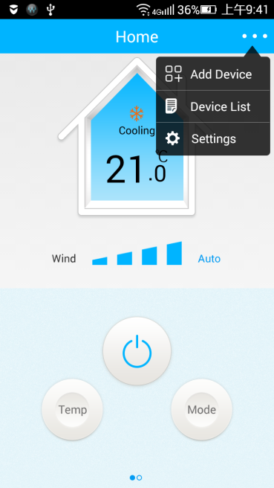
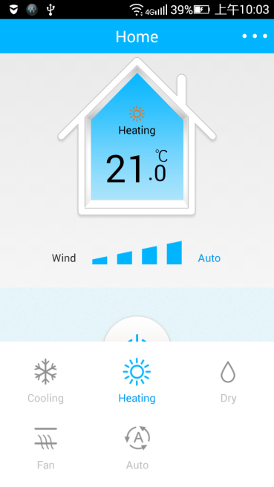
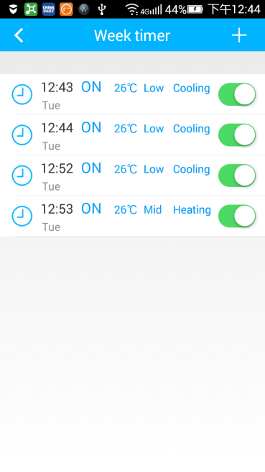
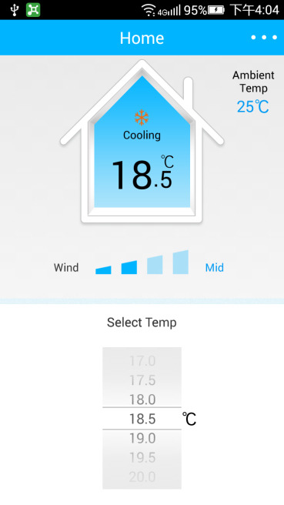
Operation
Operating Interface
Cooling Mode
Heating Mode/
Five operation modes
Week Timer
Temperature/Wind
Selection

Slide 7
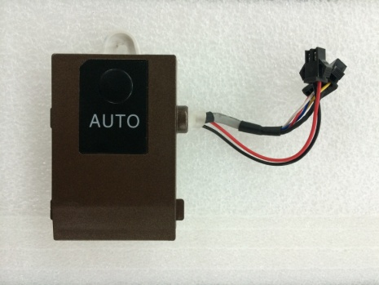
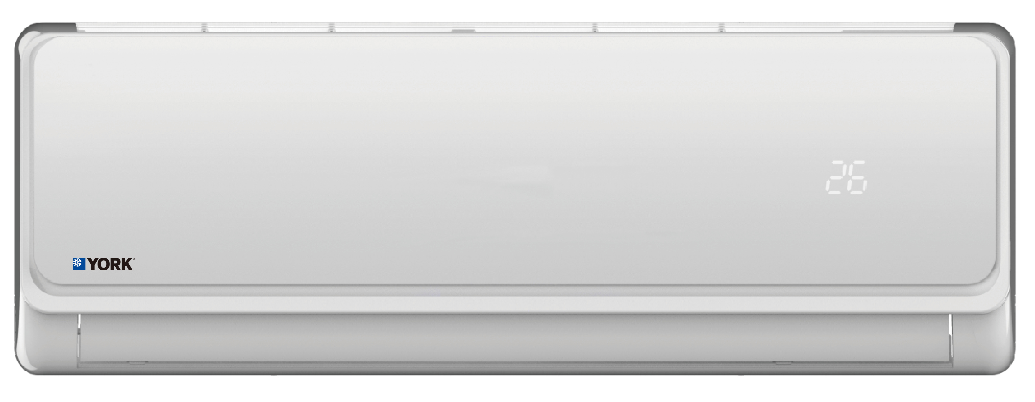
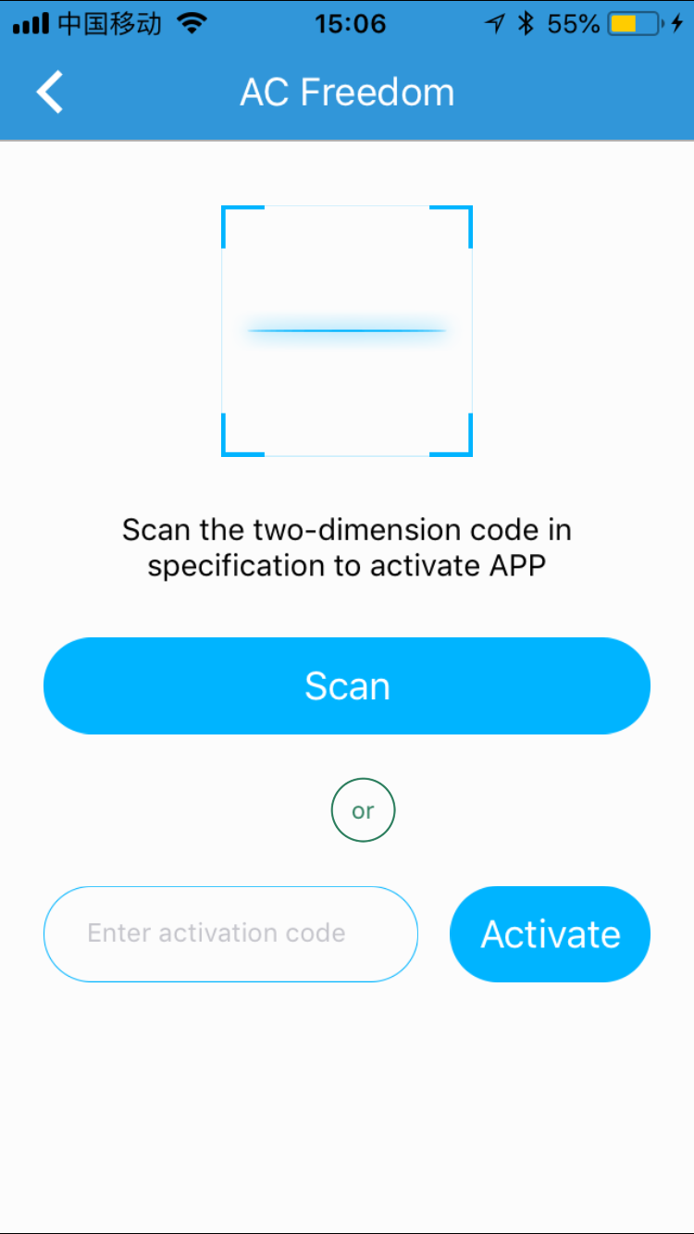
More Control Options
Remote Control
Module
Family
Model
Optional WIFI Adapter
Cloud Serve
Air Conditioner
Mobile

Slide 8
AC Freedom
APP Introduction
WIFI Module Installation
Model for 60Hz 115V 12K High Wall Inverter
Model for others
60Hz 230V High Wall Inverter
60Hz 230V High Wall Fixed
60Hz 115V High Wall Fixed
50Hz 220V High Wall Inverter
50Hz 220V High Wall Fixed

Slide 9
WIFI Module Installation
WIFI device Installation on 60Hz 115V 12K High Wall Inverter
Models | Description
YHJE12ZX6AXBORX | 60 Hz 115V High Wall Inverter 12K Cooling Only
YHKE12ZX6AXBORX | 60 Hz 115V High Wall Inverter 12K Heat Pump

Slide 10
Guide Book
1. Open the panel, and you will find a little terminal on right side.

Slide 11
Guide Book
2. Connect the WIFI’s terminal.

Slide 12
Guide Book
3. Fix the WIFI device to the Panel.
(There will be a space reserved in the panel).

Slide 13
Guide Book
4. If there isn’t a available terminal outside,
please open the medium frame connecting wires cover.

Slide 14
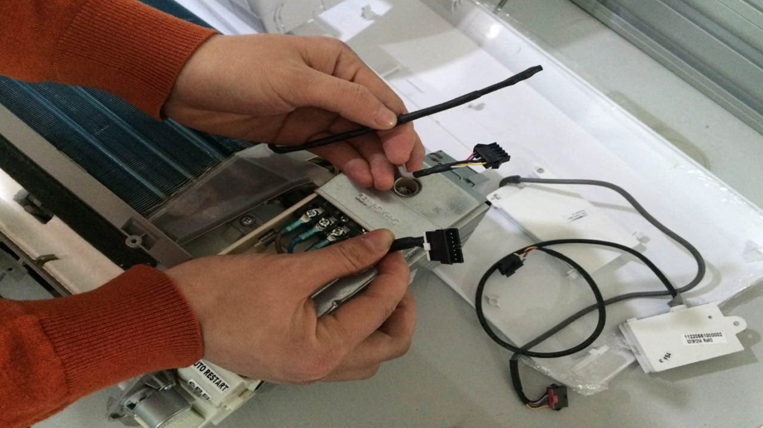
Guide Book
5. Find the wire for WIFI device and pull it out.
Sensor
WIFI
For display board

Slide 15
Guide Book
6. Then please repeat the steps from 1-3.

Slide 16
AC Freedom
APP Introduction
WIFI Module Installation
Model for 60Hz 115V 12K High Wall Inverter
Model for others
60Hz 230V High Wall Inverter
60Hz 230V High Wall Fixed
60Hz 115V High Wall Fixed
50Hz 220V High Wall Inverter
50Hz 220V High Wall Fixed

Slide 17
WIFI Module Installation
WIFI device Installation on below models
Models | Description
YHJE12ZJ6AXBORX | 60Hz 230V High Wall Inverter 12K CO
YHJE18ZJ6AXBORX | 60Hz 230V High Wall Inverter 18K CO
YHJE24ZJ6AXBORX | 60Hz 230V High Wall Inverter 24K CO
YHKE12ZJ6AXBORX | 60Hz 230V High Wall Inverter 12K HP
YHKE18ZJ6AXBORX | 60Hz 230V High Wall Inverter 18K HP
YHKE24ZJ6AXBORX | 60Hz 230V High Wall Inverter 24K HP
YHKE09ZEEAXAORX | 50Hz 220V High Wall Inverter 9K HP
YHKE12ZEEAXAORX | 50Hz 220V High Wall Inverter 12K HP
YHKE18ZEEAXAORX | 50Hz 220V High Wall Inverter 18K HP
YHKE24ZEEAXAORX | 50Hz 220V High Wall Inverter 24K HP
YHFE12ZXMAXAORX | 60Hz 115V High Wall Fixed 12K CO
YHGE12ZXMAXAORX | 60Hz 115V High Wall Fixed 12K HP
YHFE12ZJMAXAORX | 60Hz 230V High Wall Fixed 12K CO
YHFE18ZJMAXAORX | 60Hz 230V High Wall Fixed 18K CO
YHFE24ZJMAXAORX | 60Hz 230V High Wall Fixed 24K CO
YHGE12ZJMAXAORX | 60Hz 230V High Wall Fixed 12K HP
YHGE18ZJMAXAORX | 60Hz 230V High Wall Fixed 18K HP
YHGE24ZJMAXAORX | 60Hz 230V High Wall Fixed 24K HP
YHGE09ZE--XAORX | 50Hz 220V High Wall Fixed 9K HP
YHGE12ZE--XAORX | 50Hz 220V High Wall Fixed 12K HP
YHGE18ZE--XAORX | 50Hz 220V High Wall Fixed 18K HP
YHGE24ZE--XAORX | 50Hz 220V High Wall Fixed 24K HP

Slide 18
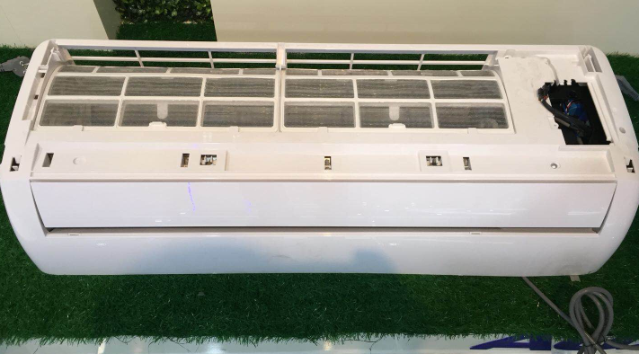
Guide Book
1. Open and Disassemble the panel.

Slide 19
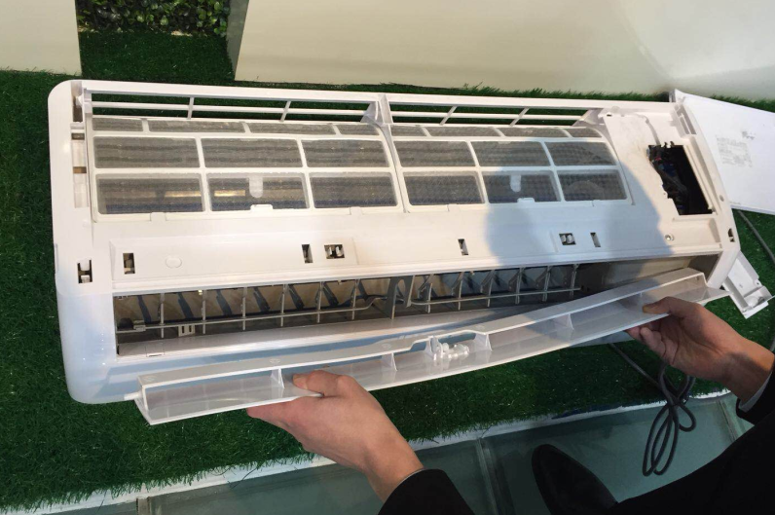
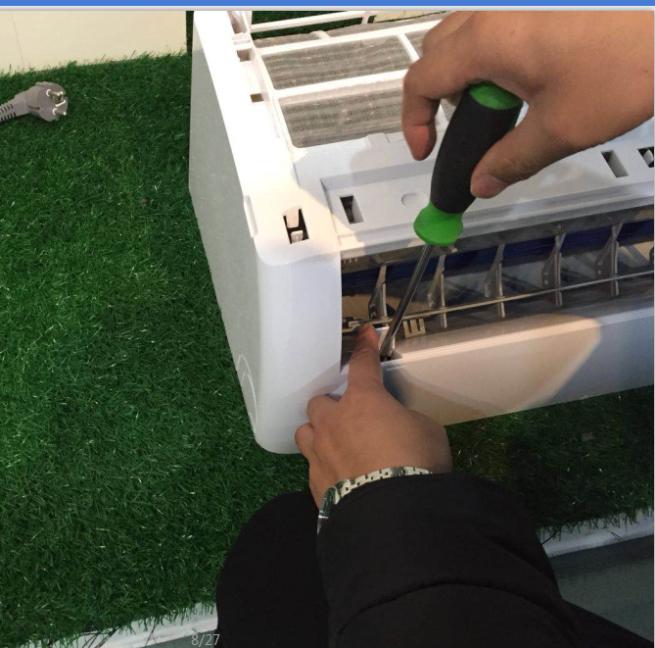
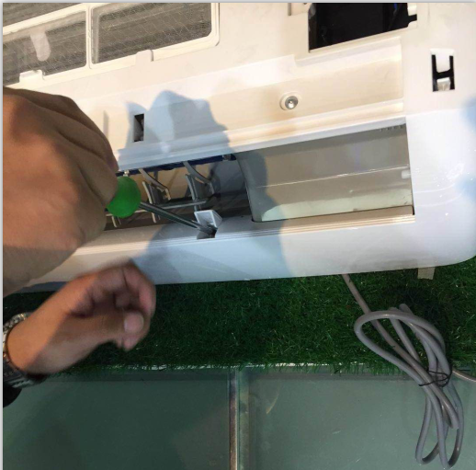
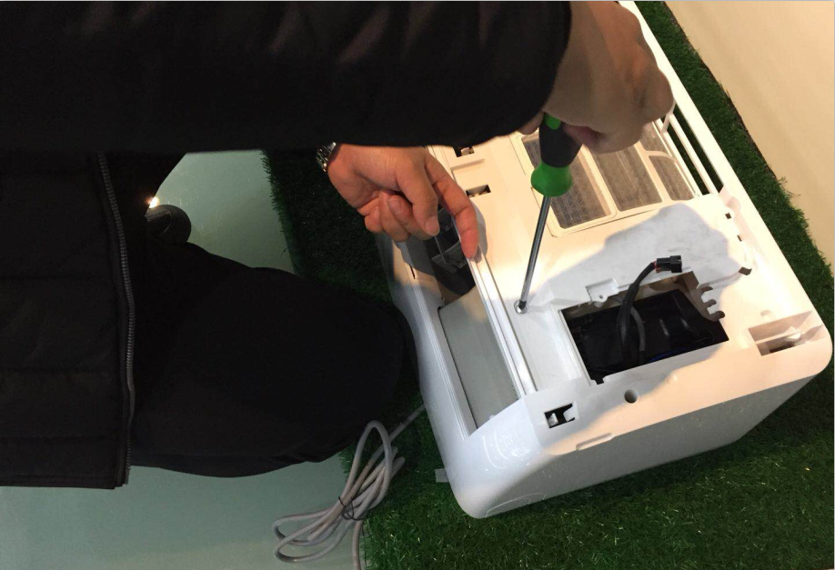
Guide Book
2. Disassemble the air louver and medium frame fix screw(3).

Slide 20
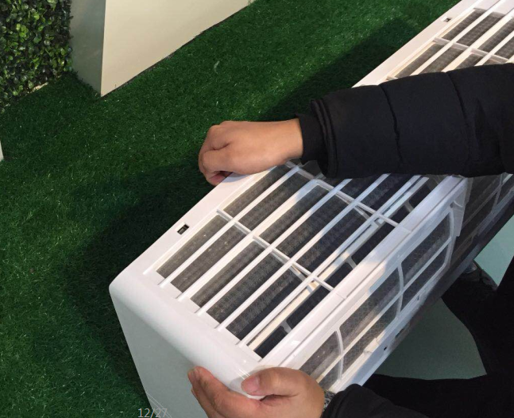
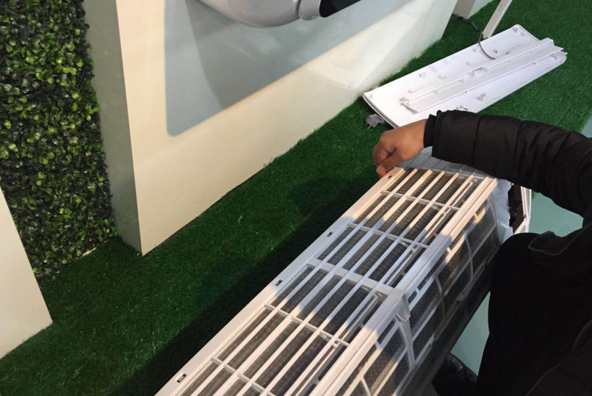
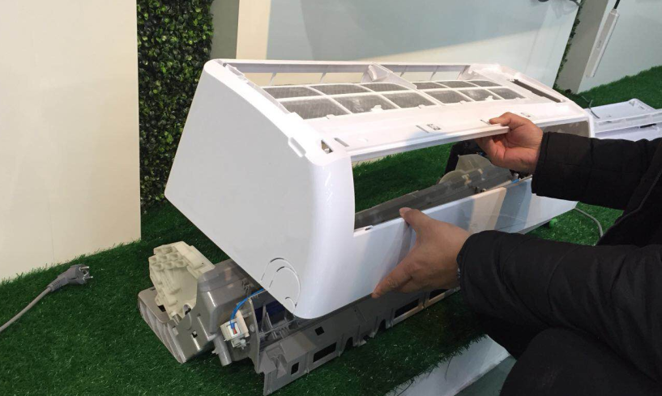
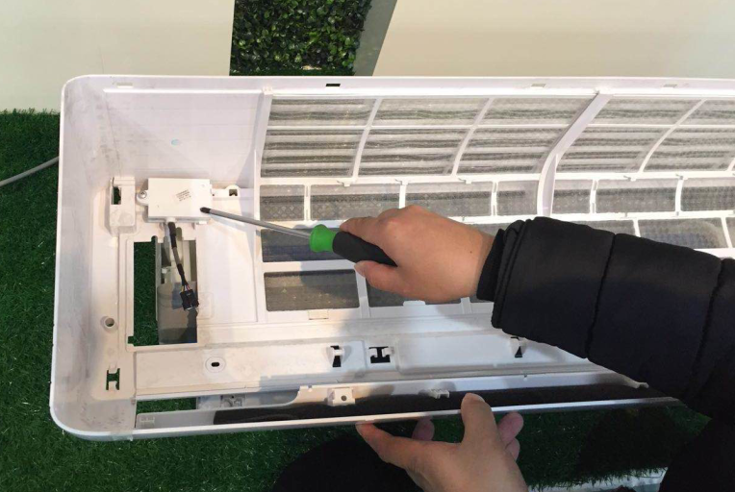
Guide Book
3. Find the 5 snap joints back of the medium frame and take them off,
then find the WIFI fixed position.

Slide 21
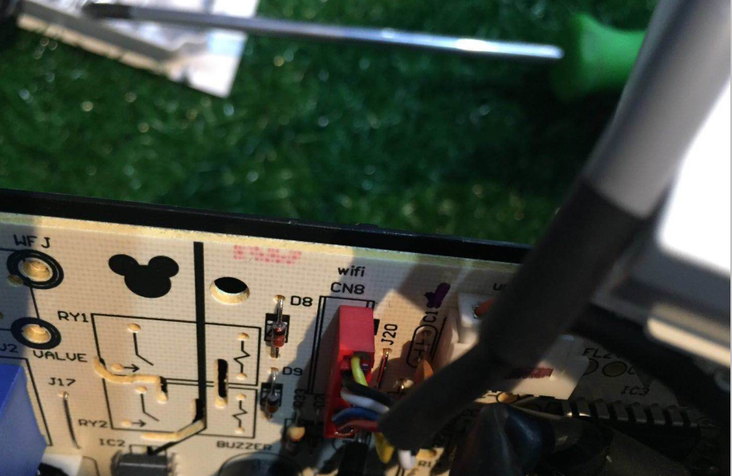
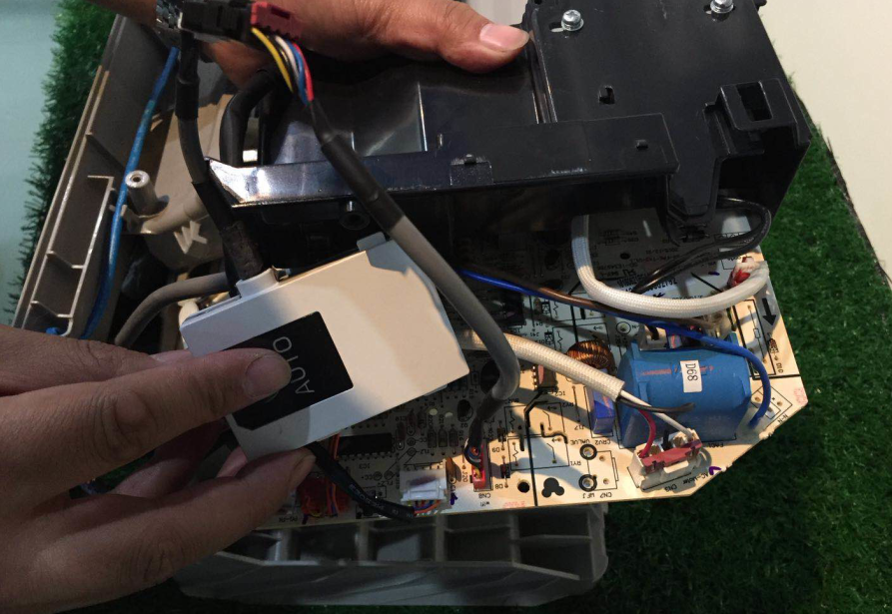
Guide Book
4. Disassemble the control box and confirm the WIFI connecting terminal and wire.

Slide 22
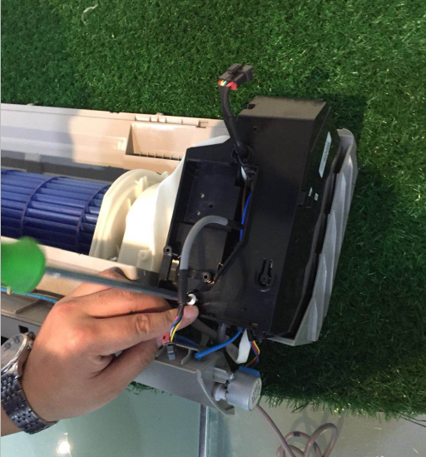
Guide Book
5. Install the control box cover and make the display board and WIFI connecting wire out of the box.
WIFI Connecting Wire

Slide 23
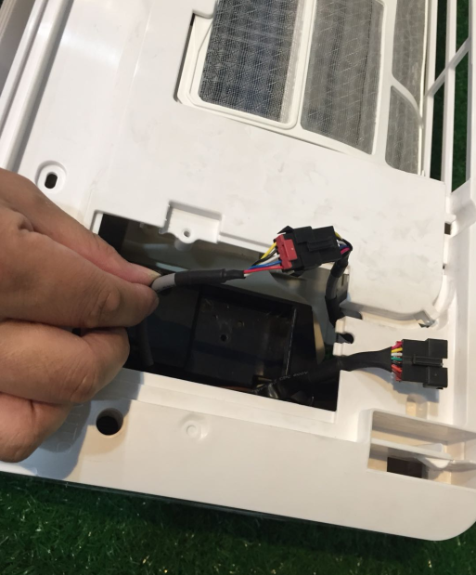
Guide Book
6. Install the medium frame, connect the terminal and then install the unit.

